Slide 1









Whiteboardmaths.com
7
2
1
5
© 2004 All rights reserved

Slide 2
8 Sector Circle

Slide 3

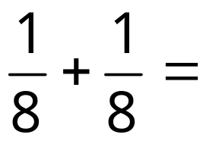
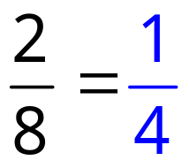


1/8 + 1/8

Slide 4
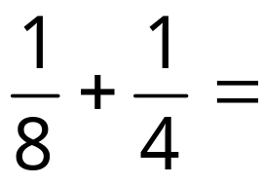

1/8 + 1/4

Slide 5
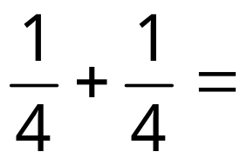
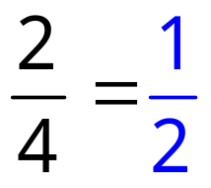
1/4 + 1/4

Slide 6
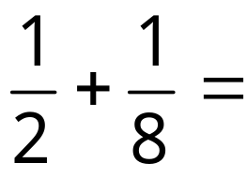

1/2 + 1/8

Slide 7
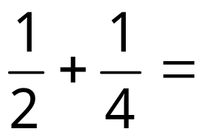

1/2 + 1/4

Slide 8
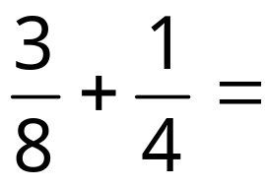
3/8 + 1/4

Slide 9
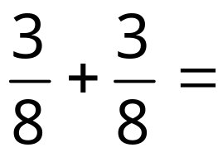
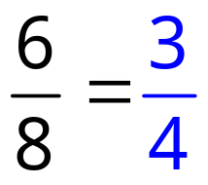
3/8 + 3/8

Slide 10
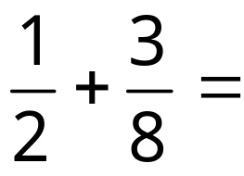

1/2 + 3/8

Slide 11
8 Sector Blank

Slide 12
Worksheet

Slide 13
12 Sector Circle

Slide 14


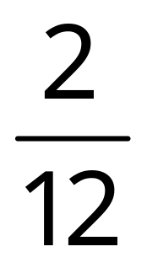
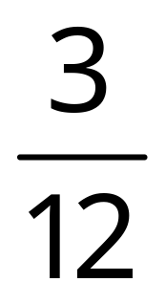
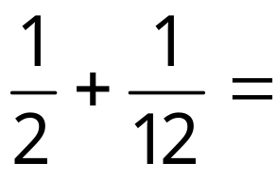




1/2 + 1/12

Slide 15
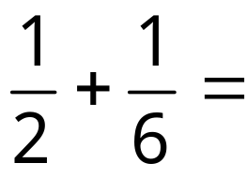
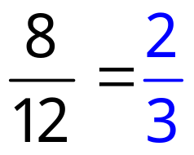
1/2 + 1/6

Slide 16
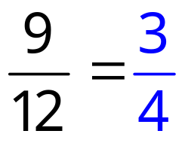
1/2 + 1/4

Slide 17
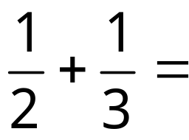
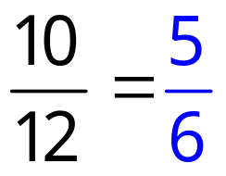
1/2 + 1/3

Slide 18
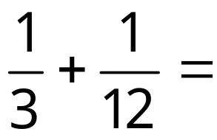
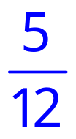
1/3 + 1/12

Slide 19
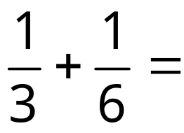

1/3 + 1/6

Slide 20
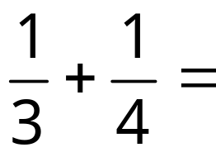
1/3 + 1/4

Slide 21
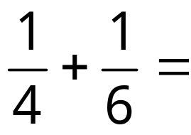
1/4 + 1/6

Slide 22
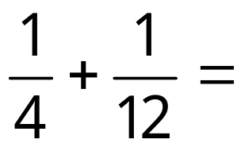
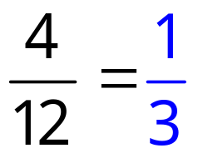
1/4 + 1/12

Slide 23
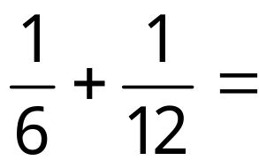
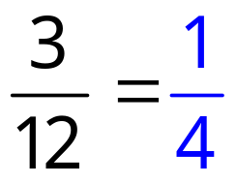
1/6 + 1/12

Slide 24
12 Sector Blank
1/6 + 1/12

Slide 25
Worksheet

Slide 26
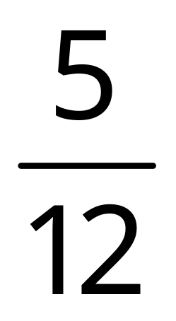
Num/Den
Addition/Subtraction of Fractions
REMEMBER:
Numerator
Denominator
Adding/subtracting fractions with the same denominator is easy. You simply add/subtract the numerators.

Slide 27
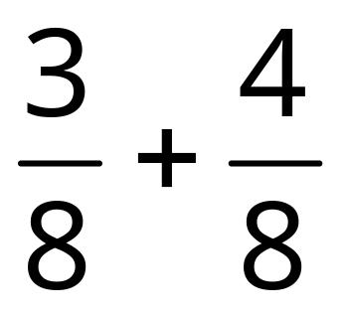
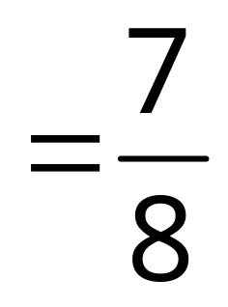
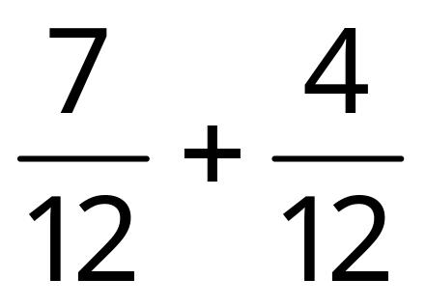
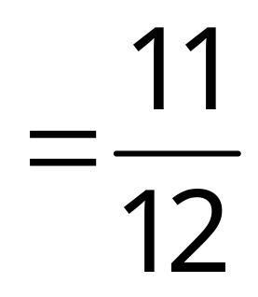
Same Den
Adding and subtracting fractions with the same denominator is easy. You simply add or subtract the numerators.

Slide 28
LCM
Adding/subtracting fractions with different denominators is more complicated. You need to find the Lowest Common Multiple (LCM) of the denominators first.
Remember: The Lowest Common Multiple of 2 or more numbers is the smallest number that the given numbers will divide into without remainder.
Find the lowest common multiple of the following numbers:
Multiples of 3 and 8
3 and 4
5 and 20
3 and 8
3
8
Multiples of 3 and 4
Multiples of 5 and 20
6
16
9
24
3
4
5
20
12
32
6
8
10
40
15
40
9
12
15
60
18
48
12
16
20
80
21
56
15
20
25
100
24
64
12 is the LCM
20 is the LCM
24 is the LCM

Slide 29

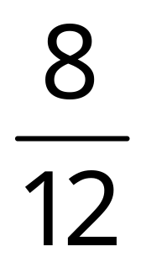
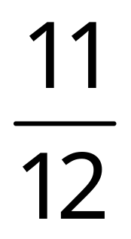
+ Diagram 1
+
Equivalent
+
Equivalent
Multiples of 3 and 4
3
4
6
8
9
12
=
12
16
15
20
12 is the LCM

Slide 30

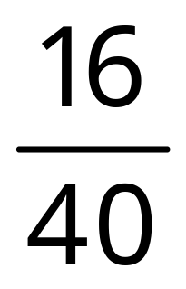
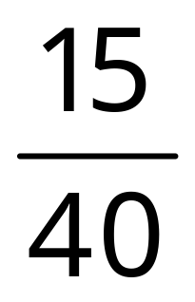
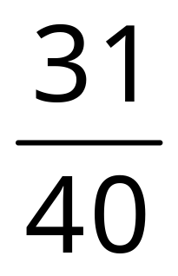
+ Diagram 2
+
Equivalent
+
Equivalent
Multiples of 5 and 8
5
8
10
16
15
32
=
20
40
25
48
30
56
35
64
40
72
40 is the LCM

Slide 31

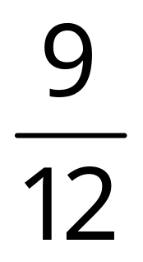
+ Diagram 3
+
Equivalent
+
Equivalent
Multiples of 4 and 6
4
6
8
12
12
18
16
24
=
20
30
12 is the LCM

Slide 32
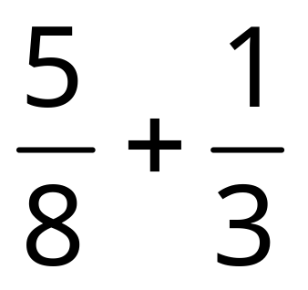
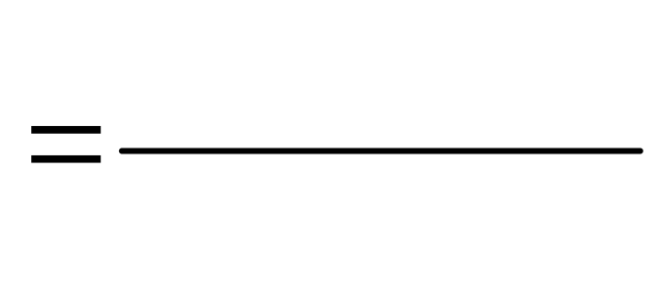
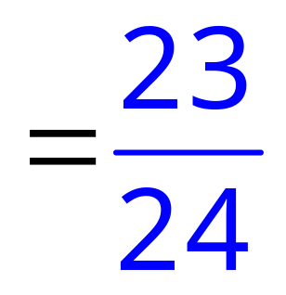
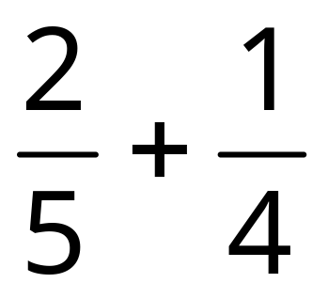
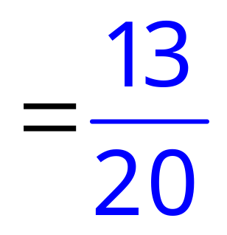
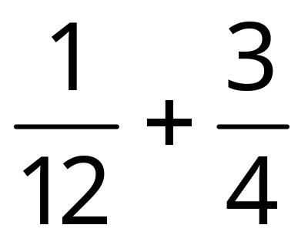
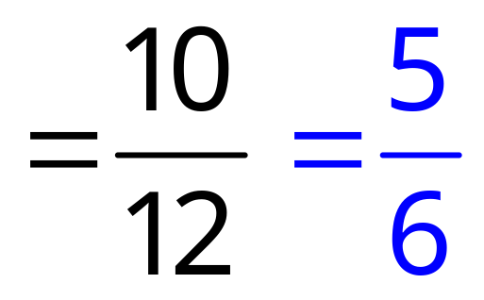
Examples + 1
Example questions
15
+
8
1
24
+
5
8
2
20
+
9
1
3
12

Slide 33
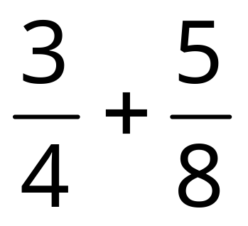
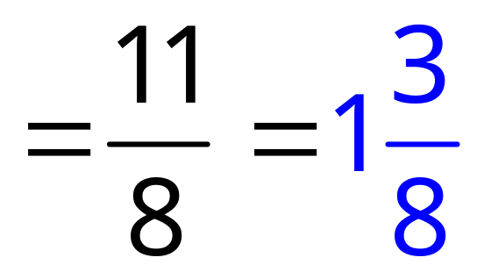
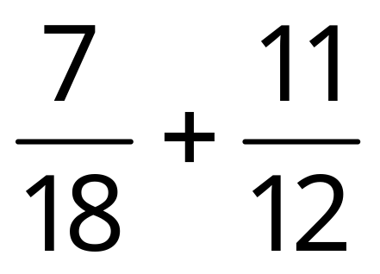
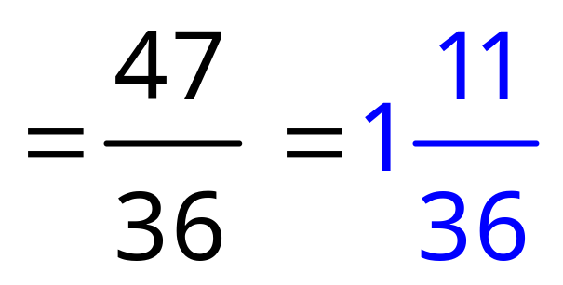


Examples + 2
Example questions
+
6
5
4
8
14
+
33
5
36
40
+
27
6
72

Slide 34
- Diagram 1
-
Equivalent
-
Equivalent
Multiples of 3 and 4
3
4
6
8
9
12
=
12
16
15
20
12 is the LCM

Slide 35
-
Equivalent
-
Equivalent
Multiples of 3 and 4
3
4
6
8
9
12
=
12
16
15
20
12 is the LCM

Slide 36
- Diagram 2
-
Equivalent
-
Equivalent
Multiples of 5 and 8
5
8
10
16
15
32
=
20
40
25
48
30
56
35
64
40
72
40 is the LCM

Slide 37

-
Equivalent
-
Equivalent
Multiples of 5 and 8
5
8
10
16
15
32
=
20
40
25
48
30
56
35
64
40
72
40 is the LCM

Slide 38
-Diagram 3
-
Equivalent
-
Equivalent
Multiples of 4 and 6
4
6
8
12
12
18
16
24
=
20
30
12 is the LCM

Slide 39

-
Equivalent
-
Equivalent
Multiples of 4 and 6
4
6
8
12
12
18
16
24
=
20
30
12 is the LCM

Slide 40






Examples - 1
Example questions
15
-
8
1
24
-
5
8
2
20
-
1
9
3
12

Slide 41






Examples - 2
Example questions
-
6
5
4
8
33
-
14
5
36
40
-
27
6
72

